Slide 1
DIGITAL DESIGN & COMPUTER ARCHITECTURE
THE BUILD PATH
From Logic Gates
to a Working RISC-V CPU
BITS & LOGIC
COMBINATIONAL
A concise overview of all six DDCA modules
SEQUENTIAL
TEAM MEMBERS::
JAYA SINDHURA- 2620030140
SAHASRA -2620030108
TANMIAYEE-2620030092
VIJAY VARMA-2620030119
MEMORY + ISA
WORKING CPU

Slide 2
MODULES 1–2 • FOUNDATIONS & COMBINATIONAL LOGIC
Start with bits, then design logic
Digital systems represent information in binary and transform inputs through logic circuits.
Module 1 — The machine & its language
Module 2 — Combinational circuits
• Computer: input → process → store → output
• Binary / hexadecimal, unsigned values and two’s complement
• Addition, subtraction, overflow and Boolean laws
• Gates: AND, OR, NOT, NAND, NOR, XOR and XNOR
• Truth tables, Boolean expressions and K-maps
• Half/full adders, multiplexers and decoders
• Comparators and arithmetic-logic unit (ALU)
• Verify circuits in Logisim / Digital
Goal
Build and test small circuits that implement clear Boolean functions.
DDCA • RISC-V CPU learning project
02

Slide 3
MODULE 3 • SEQUENTIAL LOGIC
Give circuits a memory of their own
Sequential circuits store state, so behavior depends on both current inputs and previous values.
Storage elements
Timing
Larger systems
Latches and flip-flops hold one bit of information.
Clock signals coordinate when registers and other state elements update.
Registers, counters and finite-state machines (FSMs).
Key distinction
Combinational logic computes; sequential logic computes and remembers state.
DDCA • RISC-V CPU learning project
03

Slide 4
MODULE 4 • REGISTERS & MEMORY
Connect storage to the CPU
Instructions and data move through a hierarchy of storage components.
MEMORY HIERARCHY
Register file
Instruction & data memory
Registers • fastest
CPU registers hold values used by instructions and the ALU.
Instruction memory supplies instructions. RAM stores data. lw reads; sw writes.
Cache
Main memory (RAM)
Storage
Design trade-offs: speed • capacity • cost • locality
Von Neumann bottleneck: transfers between CPU and memory can limit performance.
DDCA • RISC-V CPU learning project
04

Slide 5
MODULE 5 • RISC-V ISA, DATAPATH & CONTROL
Explain how a program becomes CPU actions
The ISA defines instructions; the datapath and control unit carry them out.
Instruction set
Instruction formats
Execution stages
add, sub, and, or, slt, addi
lw, sw, beq, jal
R, I, S, B, U and J
Opcode, registers and immediate fields
Fetch → Decode → Execute → Memory → Write back
PC
Instruction
Memory
Register
File
ALU
Data
Memory
Example: add x3, x1, x2 → x3 = x1 + x2
DDCA • RISC-V CPU learning project
05

Slide 6
MODULE 6 • BUILD, TEST & EXTEND
From a datapath
to a working CPU
CAPSTONE GOAL
A simulated RISC-V CPU that fetches, decodes and executes a real program.
Integrate the blocks, execute a real program in Ripes, and validate the design step by step.
BUILD
Connect PC, instruction memory, register file, ALU, data memory and control.
Then extend it with simple I/O and verify its behavior with tests.
EXTEND
Add XOR or a custom instruction; connect memory-mapped LEDs or a display.
MEASURE
Understand clock period, CPI, pipelining, cache and parallelism.
Thank you
APPLY
Explore embedded systems, IoT, CMOS/VLSI and edge AI / TinyML.
DDCA • RISC-V CPU learning project

Slide 7
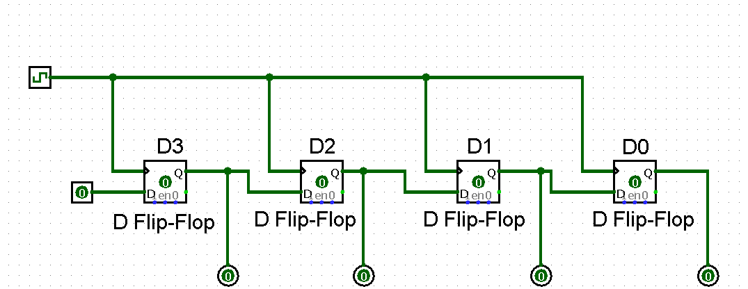

Slide 8
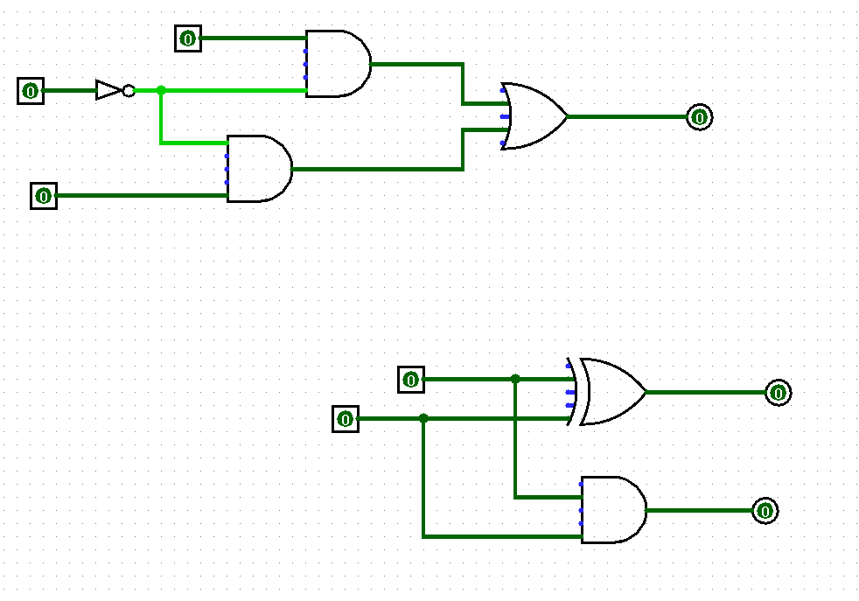

Slide 9
